Slide 1

2025-2026
Clark County
Social Service
The Outside
Agency Grant (OAG)
25/26 Application
Process

Slide 2


BACKGROUND
The Outside Agency Grant (OAG) has been in operation since at least 2001 and has dispersed more than $90 million in funds into Clark County since then.
The program is designed to supplement services provided directly by the County or are funded in lieu of the County’s needing to establish such programs.
Projects must provide services and assistance that substantially benefit Clark County residents, including:
  Programs and services needed by disadvantaged citizens to increase their self-sufficiency and personal independence;
  Programs or events that foster community pride or cohesiveness; and/or
  Facilities and projects that strengthen community infrastructure.
Grant applications are only accepted from nonprofits and local government entities.

Slide 3

Please note:
This presentation is meant to supplement the Application Instructions and does not cover all the information supplied in that document.
The questions asked in this presentation will be aggregated and put in the FAQ which can be found on our website.

Slide 4
OAG is split into two tracks:
DEPARTMENT
INITIATIVES ($1.5 MILLION)
COMMUNITY
INITIATIVES
($1.5 MILLION)
The Department Initiative track is only open to non-profits or government agencies that have been awarded an OAG grant applying as a Department Initiative in the past.
The Community Initiative Track is open to all non-profits and government agencies with programs that meet the aims and purpose of the grant (as delineated in the Application Instructions).
.

Slide 5
Important Dates
Pre-Application Opens | Monday, January 13th, 2025, 8:00 am
Pre-Application DEADLINE | Monday, January 27th, 2025, 4:00 pm
Pre-Submittal Application Overview Meeting (optional) | Wednesday, January 29th, 2025, 10 am – 11:30 am Pre-Submittal Application Overview Meeting Link (click here)
Office Hours (optional) | (1) Wednesday, February 5th, 10 am – 12 pm Feb 5th Office Hours Meeting Link (click here) (2) Tuesday, February 11th, 10 am – 12 pm Feb 11th Office Hours Meeting Link (click here) (3) Thursday, February 20th, 3 pm - 5 pm Feb 20th Office Hours Meeting Link (click here)
Full Application CLOSES | Wednesday, February 26th, 2025, at 4:00 pm
You are here
.
DEADLINE FOR COMPLETING ENTIRE OAG APPLICATION
is Wednesday, February 26th, 2025, at 4:00PM, PST
The notification of grant awards will take place in June of 2025.
Notes:
Highlight the substantial change to the application period, wherein there will be no technical assistance given after the submission of the application. Rather, it will be incumbent on the applicants to self-seek out assistance prior to the submission with any questions they may have. To do this, the office hours, FAQs, and CRMInfo Box must be utilized.

Slide 6
Is my agency ready for the Outside Agency Grant?
There are several administrative burdens that being awarded the OAG will place on your agency. Consider the following with your team as you make the decision to proceed:
Recipient must obtain and maintain all federal, state, and local licenses, and permits (including professional certifications, as necessary) to operate the Project;
Recipient must Carry or provide Comprehensive Liability Insurance, including professional malpractice insurance where appropriate, as well as Comprehensive Fire and Hazard Insurance covering the full replacement costs of the Program where applicable;
  If recipient uses a vehicle in providing the services, the Recipient shall carry or provide Comprehensive Automobile Liability Insurance covering bodily injury and property damage, with minimum coverage as follows:
    Bodily Injuries: $1,000,000 each person; $1,000,000 each occurrence
    Property Damage: $1,000,000 each person; $1,000,000 each occurrence;
Recipient must avoid all activities or appearances of conflict of interest, namely: no officer, agent, consultant, or employee of Recipient may use her/his position to secure or grant any unwarranted privilege, preference, exemption, or advantage for her/himself, any member of her/his household, any business in which s/he has a financial interest. This prohibition particularly applies to the awarding or execution of any contract, subcontract, or agreement with respect thereto, or the proceeds thereof, either for her/himself or for those whom s/he has family or business ties, during her/his tenure or for one year thereafter, for any work to be performed pursuant to this Project;

Slide 7
Is my agency ready for the Outside Agency Grant?
There are several administrative burdens that being awarded the OAG will place on your agency. Consider the following with your team as you make the decision to proceed:
Recipient shall record all costs of the Program by budget line items, supported by adequate source documentation (including checks, payrolls, time records, invoices, contracts, vouchers, orders, and other accounting documents evidencing the propriety of all costs) in a ledger separate from all other revenue sources; and the Recipient shall make these financial records available to County staff for audit whenever requested.
  To meet fiscal requirements, recipient agencies must have:
    Adequate accounting records that provide reliable, complete and up-to-date information about sources and uses of funds, including retention of “source documentation” (receipts, invoices, etc.) for all financial transactions;
    Adequate internal controls that warrant against misuse of funds or unallowable expenditures;
    Bank account in the name of the agency; and
    All checks made payable to any Board Member or the Executive Director (reimbursements, mileage, payroll, etc.) must be signed by two authorized persons.
Recipient must plan on meeting all requirements regarding Reimbursement Guidelines materials and trainings.
Recipients are required to respond to OAG staff inquiries or request for information by due dates given.
Recipients should have three months of program operating costs in reserve, as reimbursement of funds can take 30 days after recipient of appropriate documentation. There may also be delays in reimbursement at the beginning of the grant period due to the administrative task of the award set up process.

Slide 8

With those requirements in mind...
Please note that a majority of OAG historical recipients have been small organizations with limited funding and staff, who have not only been able to meet the requirements with their limited capacities but been able to use the funding to create long-lasting change in our community.
We encourage all eligible organizations, from large organizations with many years of grant experience to their name, to smaller organizations, who are looking to gain experience with grant writing and management, to apply.

Slide 9
OAG Application Changes for the 25/26 Grant Year
There are several substantive changes to the application process this year, including a new scoring process and the implementation of three optional online open Office Hours, where applicants will have the chance drop-in to ask technical questions about the application process. Additionally, all frequently asked questions and questions posed by applicants will be aggregated every Thursday and posted to the OAG website for applicant’s reference.
These changes will eliminate the need for technical assistance after the application has closed, which is historically how OAG has operated. It is therefore important that the application that is submitted is complete and meets all the requirements set forth in the application instructions. This application instruction PowerPoint has also been supplied to help applicants visualize common mistakes so as to avoid them when submitting their application.

Slide 10
Full application in ZoomGrants
Community Initiative | Department initiative
22 Questions 16 attachments | 25 questions 16 attachments
  The next two slides will cover parts of the full application which will be scored at a higher point value (see rubric for more information), and therefore we will highlight them here.
Due Dates
Open from approval of pre-application to February 26th, 2025, at 4 pm.

Slide 11
Question #7
Program Description and Expected Outcomes.
Social Service will review and score the proposed program description and program outcomes. Social Service will assess whether the program outcomes are specific, measurable, attainable, relevant to the program outcomes, and time bound (S.M.A.R.T.), as well as if the program description aligns with the chosen priority track. Social Service will look for a thorough answer that ensures all parts of the question have been answered.
To earn full points, the program overview must be clear and comprehensive, effectively detailing how the project aligns with the selected funding category. The program outcomes need to be specific, measurable, attainable, relevant to the program outcomes, and time bound. The alignment with the priority track must be thoroughly explained.
See slide #12 for more information about how to create S.M.A.R.T. goals

Slide 12
Question #9
(Department Initiative Only)
Program Linkage to County Services
Social Service will review and score the program linkage to county services. Social Service will assess whether the proposed program aligns to the chosen department. Social Service will look for a thorough answer that ensures all parts of the question have
To earn full points, the program linkage must be clear and comprehensive, effectively detailing how the project aligns with the selected county department. All parts of the question must be answered.

Slide 13
Application
    Attachment 3, Program Outcomes & Measures
    Attachment 4,
    Attachment 5,
    Attachment 6,
    Attachment 7,
    Attachment 8,
    Attachment 9,
    Attachment 10,
    Attachment 11,
    Attachment 12,
    Attachment 13,
    Attachment 14,
    Attachment 15,
    Attachment 16,
Summary of Attachments
Pre – Application
    Attachment 1,
    Attachment 2,
To receive full points, each applicant must provide all Attachments.
If an Attachment is not relevant, provide a statement of non relevance on official agency letterhead.

Slide 14
ALL APPLICANTS must complete and attach all required documents listed below (1-16).
Exception #1: Governmental agencies are ONLY required to complete items 3, 4 5, 15, and 16. However, governmental agencies are required to draft and sign a written memo stating the exception to Attachments (1-2 and 6-14) on official agency letterhead and attach this memo to the slots for attachments 1-2 and 6-14. Failure to do so will impact their application score.
Exception #2: Attachments 11, 12, and 13 are required for all organizations who have not received Clark County Social Service OAG funding in the last three grant years (since FY 2021-2022). If the applicant's organization has received Clark County Social Service OAG funding within the last three grant years, they must upload a memo on official agency letterhead in lieu of the attachments which states which year(s) OAG funding has been received. Failure to attach this memo will impact their application score.
Exceptions to Attachments

Slide 15
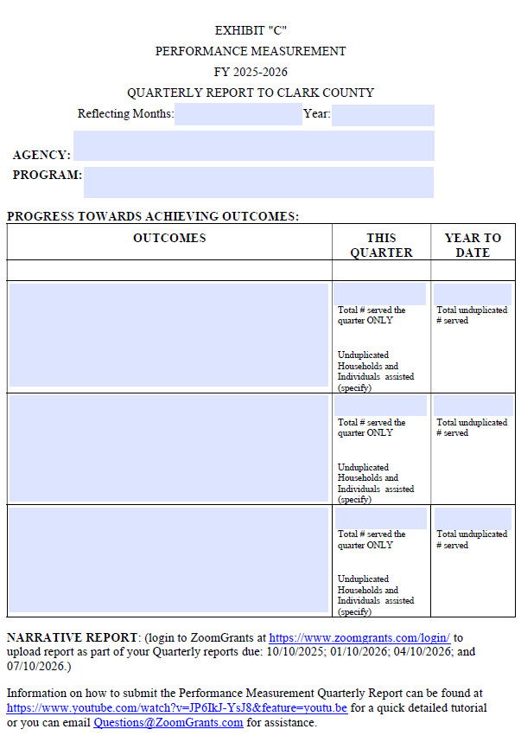



Attachment #3 :Program Outcomes & Measures
  Only one program outcome is required, though more are encouraged.
  These should be SMART goals:
    Specific: Clearly define the goal and avoid vague language.
    Measurable: The goal should be able to be quantified. Think about how you will track progress and know when the outcome is achieved.
    Attainable: based on prior knowledge of the program and/or your capacity as an organization
    Relevant: The goals should match the purpose of your program as described in the body of the application
    Timely: These goals should be achieved within the grant year
Click here for an explanation about how to create strong Performance Outcomes
Make sure to include an estimate of how many people will be served by this goal

Slide 16
Non-S.M.A.R.T. Goals | S.M.A.R.T. Goals
Provide transportation to seniors to and from medical appointments | Provide transportation to 500 seniors to and from medical appointments as documented by driver logs
Improvement in healthy behaviors | There will be a 75% improvement in healthy eating behaviors in at-risk teens as measured by pre- and post-program surveys
Assist low-income individuals with job training | Assist 50 low-income individuals with six-weeks of job training, which will result in 80% of participants having at least one interview.

Slide 17
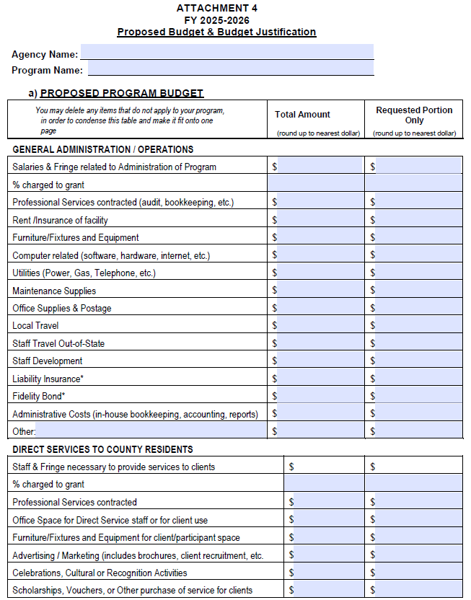

Attachment #4: Proposed Budget Spreadsheet (page 1)
Click here for a list of allowable costs under the Outside Agency Grant and explanations of the difference between direct and indirect costs
If requesting salary, please make sure to include the percentage of the employee’s total salary/salaries is being requested

Slide 18
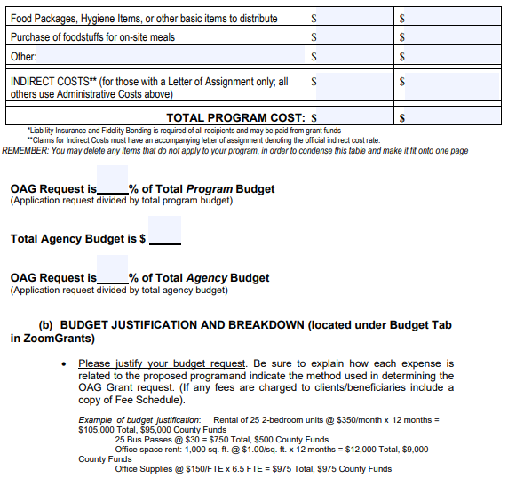

Attachment #4: Proposed Budget Spreadsheet (pg 2)
double check math
required
(double check math)
required
(under budget tab in ZG)

Slide 19
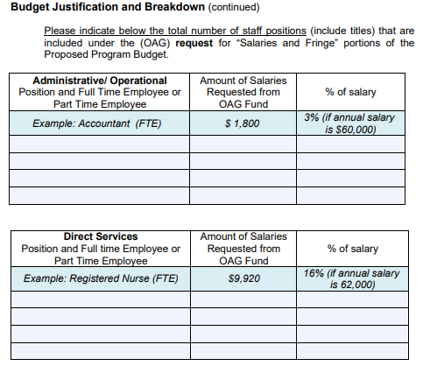

Attachment #4: Proposed Budget Spreadsheet (pg 3)
Total from this column must match requested amount here on pg. 1
required
if requesting salary
Total from this column must match requested amount here on pg. 1

Slide 20
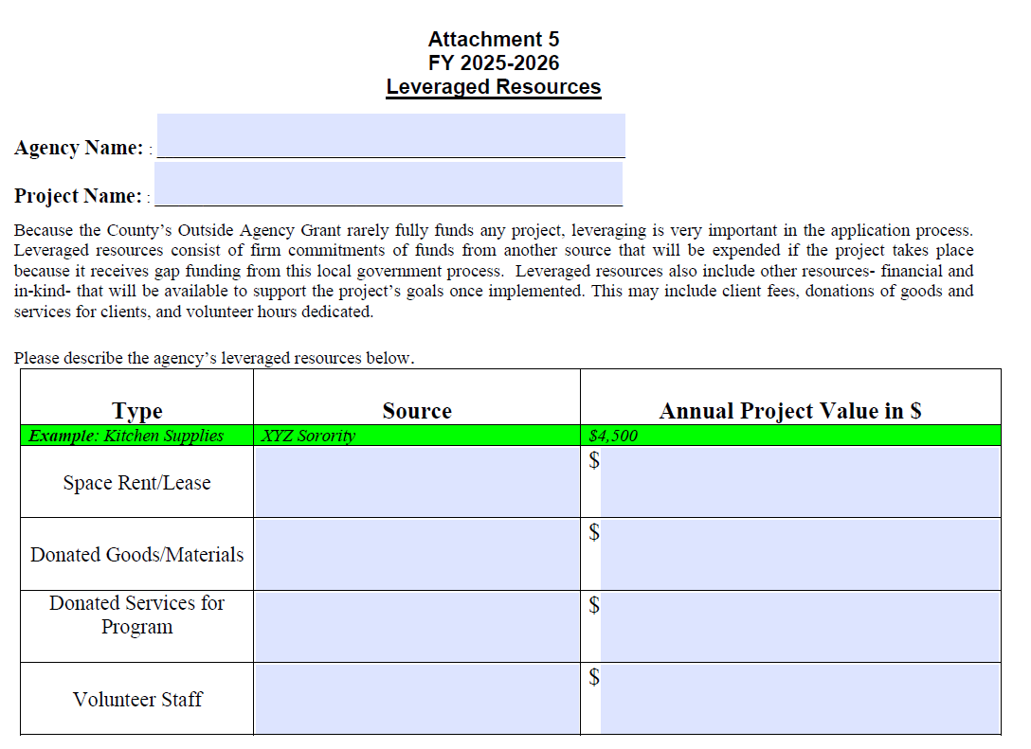
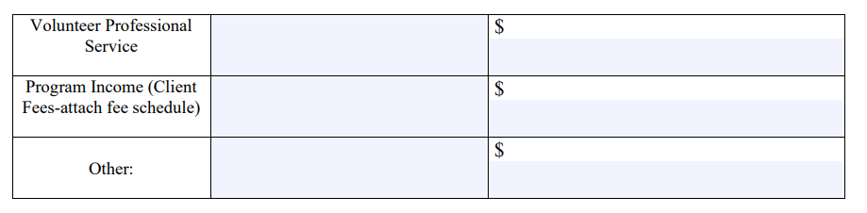
Attachment #5: Leveraged Resources
Leveraged resources refer to the additional support and assets that a project can access beyond the primary grant funding. These resources can come from various sources and help to maximize the impact of the grant. They can include:
  Financial Contributions:
    Such as donations and program income.
  In-kind Contributions:
    Non-cash support, such as donated goods, services, or volunteer time. Examples include donated office space, equipment, or professional services.
      Use this resource to calculate the in-kind contribution of volunteers.
  Existing Assets:
    Utilizing existing resources within your organization, such as staff expertise, facilities (space), or technology.
By leveraging these resources, you demonstrate your ability to mobilize additional support and enhance the overall effectiveness and sustainability of your project.

Slide 21
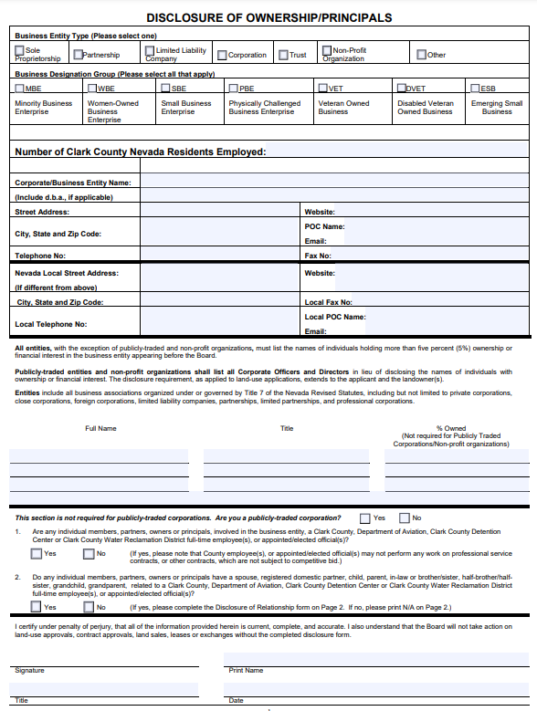

Attachment #6: Disclosure of Ownership and Board of Directors List
Checking one of these boxes is mandatory. Do not
leave blank.
Entering a number here is mandatory. Do not leave blank. (if your organization has zero employees, mark 0 here)
Filling this out is mandatory. Do not leave blank.
Answering this question is mandatory. Do not leave
blank.
A signature is mandatory

Slide 22
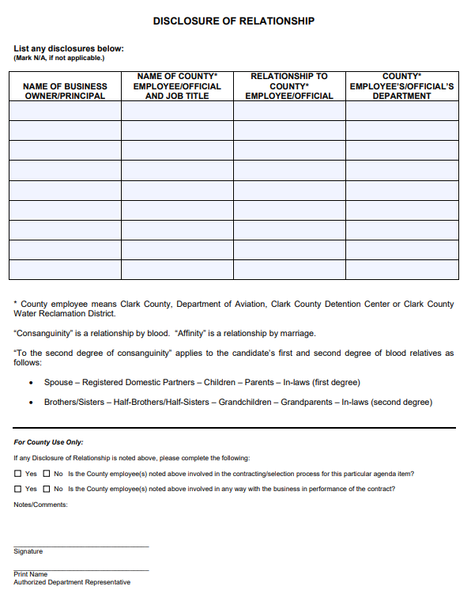
Attachment #6: Disclosure of Ownership and Board of Directors List (continued)
Please review and disclose relationships if applicable.
If no relationships exist, you MUST mark N/A on a line of the table.

Slide 23
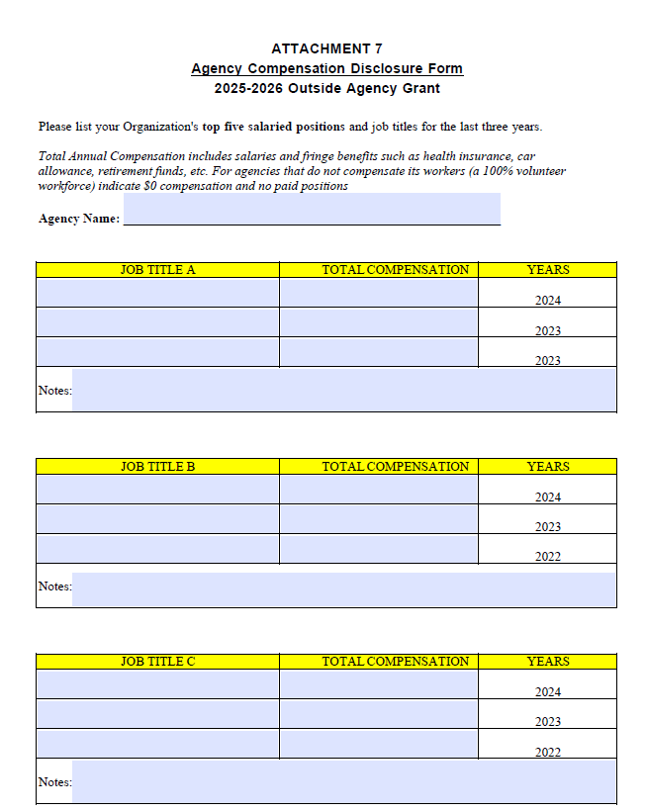
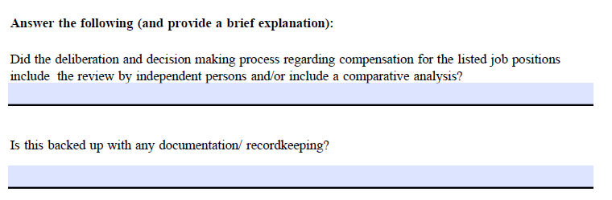
Attachment #7: Agency Compensation Disclosure Form
Please list your Organization’s top five salaried positions and job titles for the last three years.
If your agency has no staff (volunteer only), please indicate $0 compensation and no paid positions.
Page 2:
Please answer each question AND provide a brief explanation.
i.e. Yes, our decision-making process was conducted by our board, who were informed by salary surveys & market research.
i.e. Yes, we back up our compensation decisions with board meeting minutes and independent review reports.

Slide 24
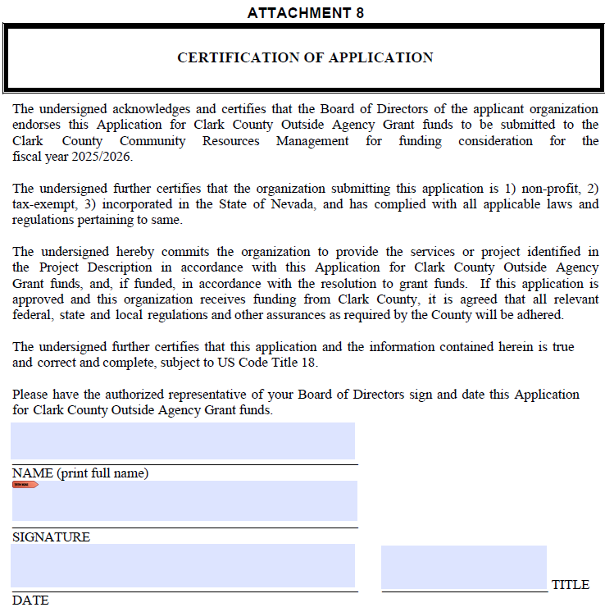
Attachment #8: Certification of Application
Must be signed by authorized representative of applicant’s Board of Directors.

Slide 25
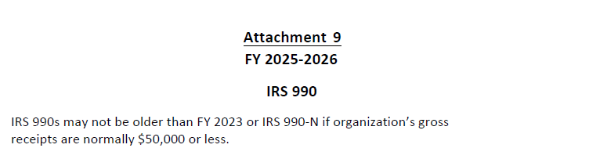
Attachment #9: IRS 990

Slide 26
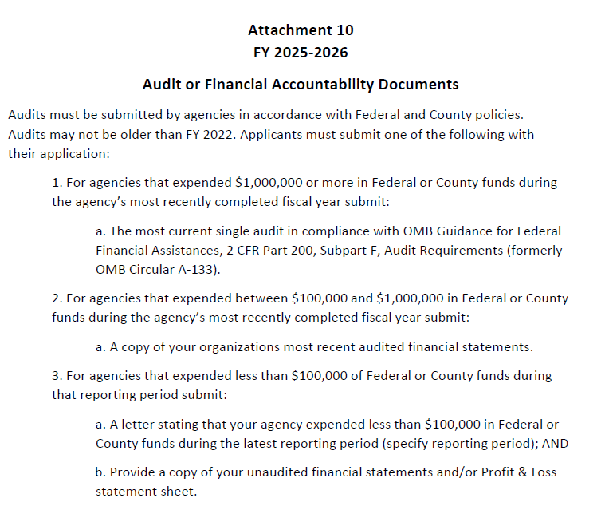
Attachment #10: Audit
    Please note: New guidance (updated October 2024) in 2 CFR 200 increases the threshold from $750,000 to $1,000,000 at which a recipient of Federal funds is required to conduct a single audit or a program specific audit.

Slide 27
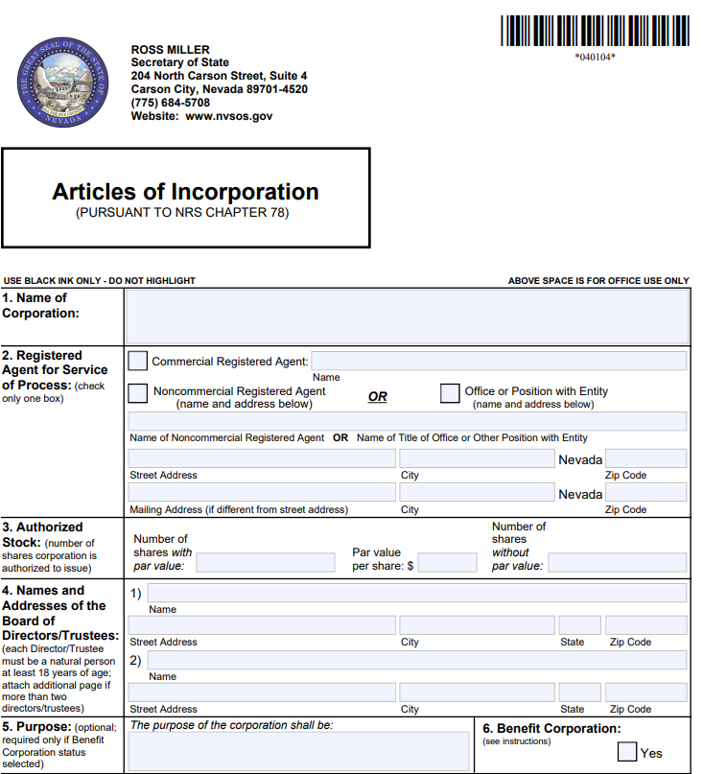
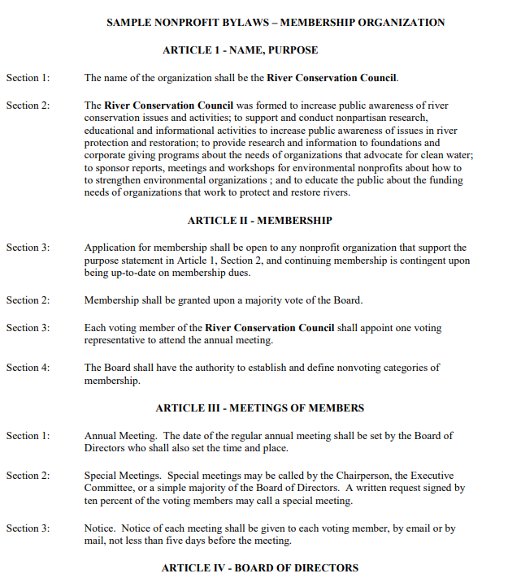
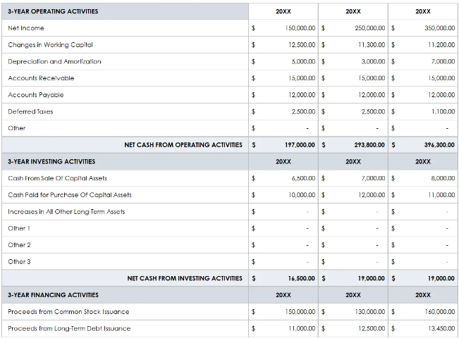
Attachments #11-13
These specific attachments are only required if your organization has not received Outside Agency Grant funding in the last 3 cycles (since 21/22). See note below.
Articles of Incorporation
By-Laws
Three-year funding history
Note: Even if you have received OAG funding in the last three cycles, you will still need to upload a memo on official letterhead stating that you have received OAG funding in the last three years and specifies the year(s) which OAG funding was received. This same memo must be uploaded for EACH of the three documents.

Slide 28
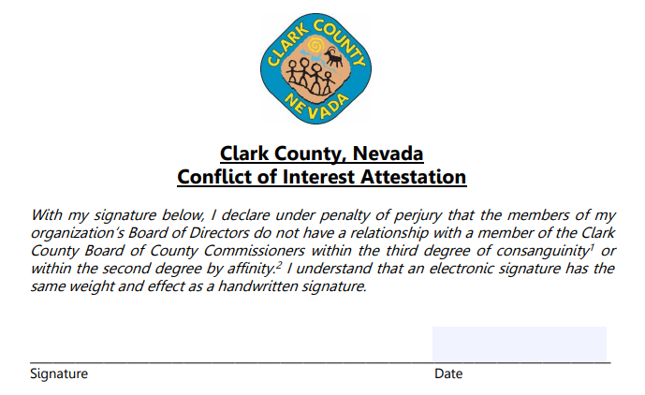
Attachment #14: Conflict of Interest Attestation
Must be signed by a member of the board (preferably the president).

Slide 29
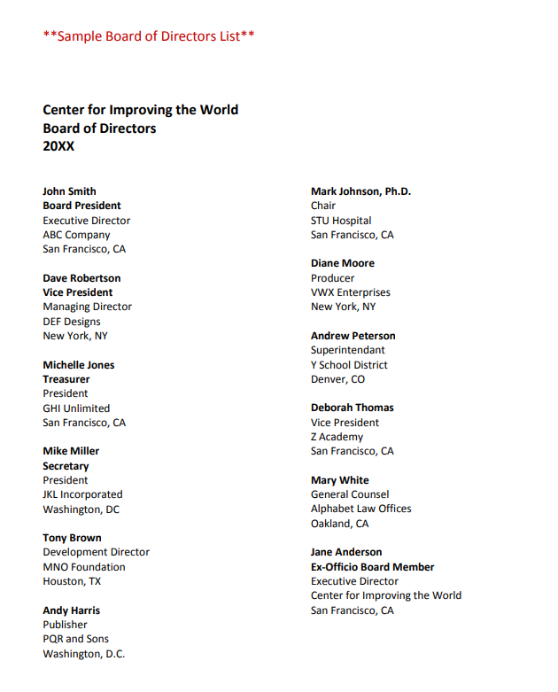
Attachment #15: Governing Body Disclosure
On agency letterhead, please list each member of your governing body, their titles, voting powers, and if they are paid.

Slide 30
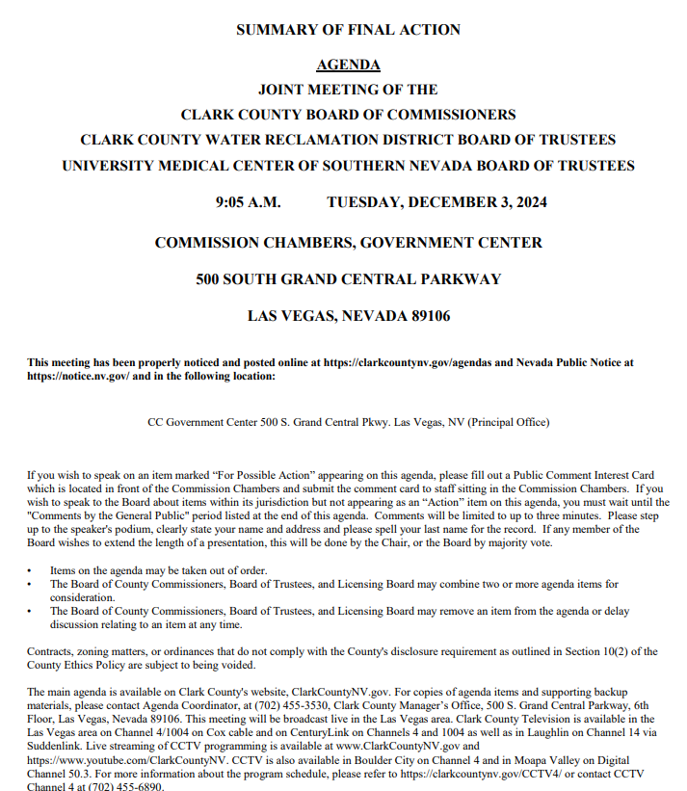
Attachment #16: Governing Body’s Most Recent Minutes
Please upload your governing body’s most recent minutes.

Slide 31
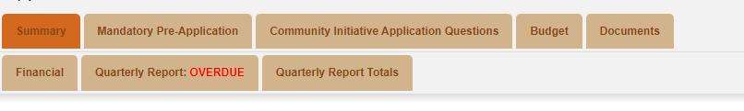
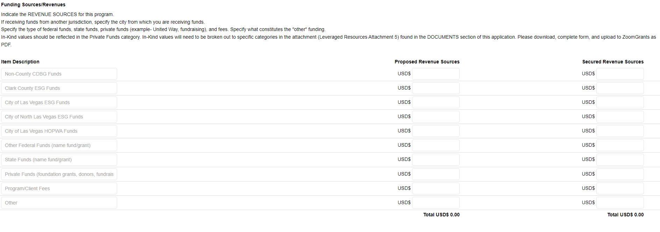

Slide 32
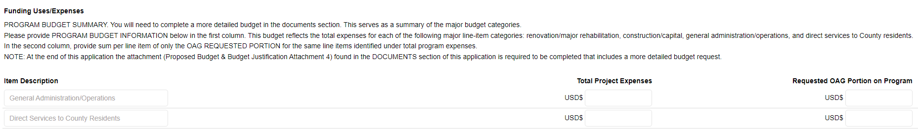

Slide 33
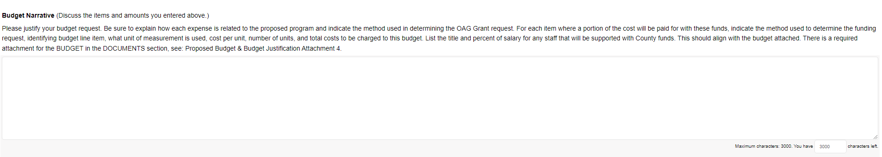
Budget Narrative
Budgets will be scored based off completeness and accuracy.
Budget must list services provided and to whom.
Social Service will review and score the proposed budget narrative (found under the “budget” tab in ZoomGrants) provided by the applicant in the required format. Social Service will look for thorough answers that ensure all parts of the question have been answered, as well as correct calculations for the proposed budget. Budget should identify services to be provided and to whom.
To receive full points, the narrative must be detailed and thorough (as well as written in complete sentences). It must connect and explain why each expense is necessary, how the funding requests were determined, and how the budget relates to the proposed program.

Slide 34
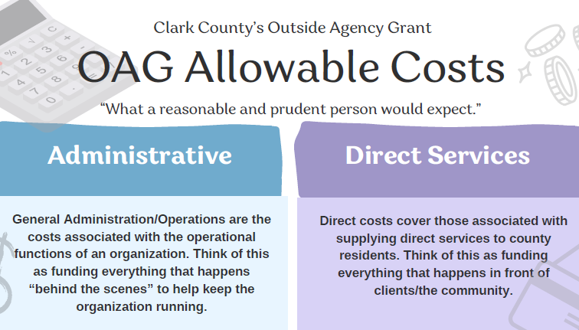
Allowable Costs
Click here for a list of allowable costs

Slide 35
Allowable Costs
Administrative | Direct Services
Salaries & Fringe related to Administration Professional services contracted (audit, bookkeeping) Rent/Insurance of Facility Furniture/Fixtures and Equipment Computer related (software, hardware, internet, etc.) Utilities (Power, Gas, Telephone, etc.) Maintenance Supplies Office Supplies & Postage Local Travel Staff Travel Out-of-State Staff Development Liability Insurance Fidelity Bond Administrative Costs (in-house bookkeeping, accounting, reports) Indirect (de minimis) costs – Must have a federal Letter of Assignment | Staff & Fringe necessary to provide services to clients Professional services contracted Office Space for Direct Service Staff or Client Use Furniture/Fixtures and Equipment for client/participant space Advertising/Marketing (includes brochures, client recruitment, etc.) Celebrations, Cultural, or Recognition Activities Scholarships, Vouchers, or other Purchase of Service for Clients Rental or Utility payments on behalf of participants Purchase of foodstuffs for on-site meals
Notes:
Mention indirect costs (de minimis) needs federal letter of assignment.

Slide 36
Non-Allowable Costs
County funds will not reimburse expenses related to fundraising activities, meals provided to staff, nor any alcoholic beverages. Cash purchases are similarly not eligible for reimbursement.
Similarly, anything not included in the allowable costs list above/in attachment #4 the Proposed Budget Spreadsheet will not be eligible under this grant.
If you are unsure, please review the materials, attend office hours, or email CRMInfo@ClarkCountyNV.gov
Notes:
Mention indirect costs (de minimis) needs federal letter of assignment.

Slide 37
Please note:
Late applications will not be accepted.
The final due date for the OAG 25/26 application is Wednesday, February 26th, 2024, at 4 p.m. PST.
Please note the time, as well as the date.
Again, no late applications will be accepted as this grant receives a high volume of applications and administrative time is needed to review and score. We appreciate your understanding and compliance.

Slide 38
What should I do with questions?
      1.) Read through the Application Instructions
      2.) Read through this PowerPoint
      3.) Read through the FAQs
      4.) Attend one of our Technical Assistance Office Hours
      5.) Email CRMInfo@ClarkCountyNV.gov and allow up to 48 working hours for a response
      Please note we are unable to offer advisory assistance about the content of your application. Our assistance is limited to technical questions.
Notes:
These links can be accessed on page ____ of the application

Slide 39
Technical Assistance Office Hours
  OAG Grants Coordinators will be hosting technical assistance virtual office hours* throughout the grant application period:
(1) Wednesday, February 5th, 10 am – 12 pm
            Feb 5th Office Hours Meeting Link (click here)
(2) Tuesday, February 11th, 10 am – 12 pm
            Feb 11th Office Hours Meeting Link (click here)
(3) Thursday, February 20th, 3 pm - 5 pm
            Feb 20th Office Hours Meeting Link (click here)
  *Note: Attendance at these office hours is optional but encouraged if you have technical questions about your application. Please note that no advisory assistance as to the content of the application questions may be given.
Notes:
These links can be accessed on page ____ of the application

Slide 40
Scoring
  Applications will be scored as-is after submission. Please ensure you are using all resources at your disposal to submit a complete application which accurately depicts your program and needs.
Notes:
These links can be accessed on page ____ of the application

Slide 41
Questions and FAQs
  If questions arise as you complete the application, please email CRMInfo@ClarkCountyNV.gov, and put “OAG Application” in the subject line.
  All questions asked through this forum will be aggregated and posted each Thursday to the OAG website. Check this FAQ first, as your question may already have been answered.

